Slide 1




Slide 2

HAMILTONIAN CYCLE

Slide 3

TEST TIME ON WARNSDORFF’S ALGORITHM
URL:https://forms.gle/M8GtMx9D5MN5Xx879
QR CODE:

Slide 4
HAMILTONIAN CYCLE
Introduction
Hamiltonian Path in an undirected graph is a path that visits each vertex exactly once.
A Hamiltonian cycle (or Hamiltonian circuit) is a Hamiltonian Path such that there is an edge (in the graph) from the last vertex to the first vertex of the Hamiltonian Path.
The task is to determine whether a given graph contains Hamiltonian Cycle or not

Slide 5
HAMILTONIAN CYCLE
Hamiltonian cycle:
The Hamiltonian cycle of undirected graph G <= V , E> is the cycle containing each vertex in V. -If graph contains a Hamiltonian cycle, it is called Hamiltonian graph otherwise it is non-Hamiltonian.
Finding a Hamiltonian cycle in a graph is a well-known problem with many real-world applications, such as in network routing and scheduling.

Slide 6
HAMILTONIAN CYCLE
IO Format
Input
Adjacency Matrix or Adjacency List representing the graph
If it is an adjacency matrix, it will be a 2D array with ‘1’ at (i,j) if there is a path from
i to j.
Output
Array which represents the Hamiltonian Path
a -> Graph
b -> Adj. List
c- > Adj. Matrix

Slide 7
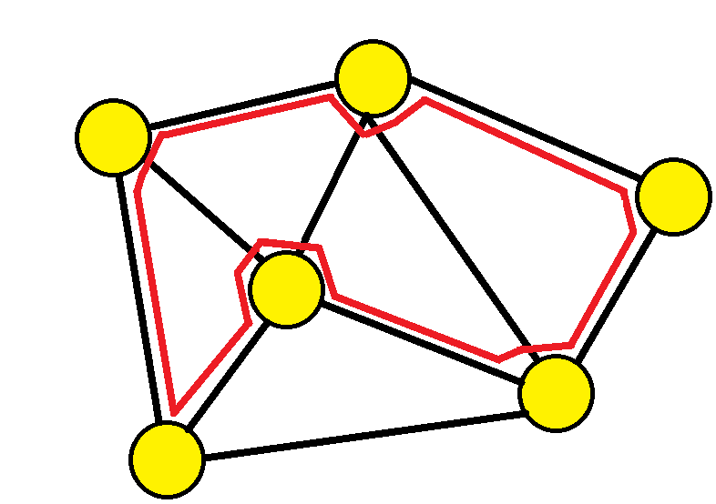
Example
Example

Slide 8
HAMILTONIAN CYCLE
Backtracking Solution
Naive approach is to generate all possible configurations (n! configurations in total) of vertices and print a configuration that satisfies the given constraints.
A better approach is to use backtracking
Create an empty path array and add vertex 0 to it. Add other vertices, starting from the vertex 1.
Before adding a vertex, check for whether it is adjacent to the previously added vertex and not already added.
If we find such a vertex, we add the vertex as part of the solution. If we do not find a vertex then we return false.

Slide 9
HAMILTONIAN CYCLE
Program
Sample IO
Input
8
0 1 0 1 1 0 0 0
1 0 1 0 0 1 0 0
0 1 0 1 0 0 1 0
1 0 1 0 0 0 0 1
1 0 0 0 0 1 0 1
0 1 0 0 1 0 1 0
0 0 1 0 0 1 0 1
0 0 0 1 1 0 1 0

Slide 10
HAMILTONIAN CYCLE
import java.util.Scanner; import java.util.Arrays; public class Main { private int V, pathCount; private int[] path; private int[][] graph; public void findHamiltonianCycle(int[][] g) { V = g.length; path = new int[V]; Arrays.fill(path, -1); graph = g; try { path[0] = 0; pathCount = 1; solve(0); System.out.println("No solution"); } | catch (Exception e) { System.out.println(e.getMessage()); display(); } } public void solve(int vertex) throws Exception { if (graph[vertex][0] == 1 && pathCount == V) throw new Exception("Solution found"); if (pathCount == V) return; for (int v = 0; v < V; v++) { if (graph[vertex][v] == 1) { path[pathCount++] = v; graph[vertex][v] = 0;

Slide 11
HAMILTONIAN CYCLE
graph[v][vertex] = 0; if (!isPresent(v)) solve(v); graph[vertex][v] = 1; graph[v][vertex] = 1; path[--pathCount] = -1; } } } public boolean isPresent(int v) { for (int i = 0; i < pathCount - 1; i++) if (path[i] == v) return true; return false; } public void display() { | System.out.print("\nPath : "); for (int i = 0; i <= V; i++) System.out.print(path[i % V] + " "); System.out.println(); } public static void main(String[] args) { Scanner scan = new Scanner(System.in); Main hc = new Main(); // Use the class name Main int V = scan.nextInt(); int[][] graph = new int[V][V]; for (int i = 0; i < V; i++) for (int j = 0; j < V; j++) graph[i][j] = scan.nextInt(); hc.findHamiltonianCycle(graph); } }

Slide 12




THANK YOU
+91 78150 95095
codemithra@ethnus.com
www.codemithra.com

